Slide 1
Juvenile Delinquency बाल अपराध
Dr. Archana Mishra
M.A. Sociology
Shia PG College, Lucknow

Slide 2
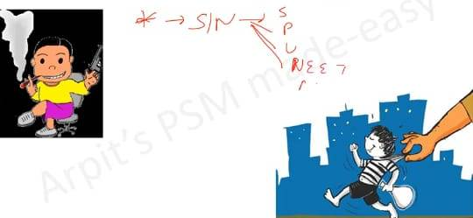
Juvenile Delinquency

Slide 3
Juvenile Delinquency
Juvenile is a boy or a girl who has not completed 18 years.
Juvenile Justice Act 2015 allows for juvenile of 16 years or older to be trial as adult for offences like rape & murder.
Delinquency – Deviation from normal youthful behaviour.
Includes habitually disobedient, those who desert their homes & indulge in Anti-social activities.
Deliquent- A child who has committed an offence.

Slide 4
Incedence & Causes
Highest incedence found in children aged above 15 years
Causes:
Biological causes : Hereditary defects, Glandular imbalance, Extra Y Chromosomes (XXY men) etc.
Social Causes : Parental neglect & broken homes (death of parents, separation of parents, stepmother)
Other Causes : Urbanization, Cinema’s & television.

Slide 5
Preventive measures
Improvement of family life: Parent should be prepared for parenthood.
Schooling: Healthy teacher student relationship.
Social welfare services : Recreation facilities & counseling.

Slide 6
Reference
Criminology Ram Ahuja.
Criminology D.S. Baghel.

Slide 7
Thank You

